Slide 1

Fonicy – Architect, Builder & Construction Services
R. Sri Kannan – 43110705

Slide 2
AGENDA
Abstract
Introduction
Scope of the project
Objectives
Module implementation
Architecture diagram
Conclusion
References

Slide 3
ABSTRACT
Fonicy is a web-based architecture and construction service platform designed to bring together every stage of the building process—from design and modeling to management and client communication—on a single digital interface. It provides users with detailed information about services such as construction, building modeling, pre-construction planning, and project management. Clients can explore completed projects, read testimonials, and contact service providers easily through the platform. Developed using Java, HTML, CSS, JavaScript, Font Awesome, and Maven, Fonicy enhances transparency, efficiency, and user experience while bridging the gap between architectural vision and practical implementation.

Slide 4
EXISTING SYSTEM
The current architecture and construction processes are manual and uncoordinated.
Clients struggle to find reliable architects and builders through traditional means.
Lack of centralized communication between clients, architects, and contractors.
Project visualization before construction is not possible, leading to confusion.
Progress tracking and documentation are done manually and often get misplaced.
Collecting client feedback or testimonials is difficult and unstructured.

Slide 5
PROPOSED SYSTEM
Fonicy introduces a centralized digital platform for architecture and construction services.
Clients can browse construction services, view completed projects, and read client testimonials in one place.
Integrates 3D building modeling for realistic design visualization before project initiation.
Provides a streamlined communication system between clients, architects, and project managers.
Enhances client satisfaction and reduces time, cost, and confusion compared to manual systems.

Slide 6
PROPOSED SYSTEM(CONT...)
Ensures transparency and reliability through real-time project updates and authentic reviews.
Features a modern, responsive interface built using Java, HTML, CSS, JS, and Maven.

Slide 7
ADVANTAGES
Centralized Platform: Combines all construction and architectural services in one system.
User-Friendly Interface: Simple, clean design for easy navigation and access.
Real-Time Project Showcase: Clients can view ongoing and completed projects instantly.
Enhanced Transparency: Testimonials and service details build trust and credibility.
Better Visualization: 3D building modeling helps clients understand designs clearly.

Slide 8
ADVANTAGES(cont..)
Improved Communication: Enables direct interaction between clients and service providers.
Time Efficiency: Reduces manual work and speeds up decision-making.
Cross-Platform Compatibility: Fully responsive design works on mobile and desktop devices.

Slide 9
DISADVANTAGES
Internet Dependency: Requires a stable internet connection for full functionality.
Initial Setup Cost: Hosting and deployment involve initial expenses.
Maintenance Requirements: Needs periodic updates and technical maintenance.
Limited Offline Access: Features are not available without an internet connection.
Technical Expertise Needed: Proper configuration and management require basic technical skills.

Slide 10
Processor: Intel Core i5 or above.
RAM: Minimum of 8 GB for efficient processing.
Hard Disk: 256 GB SSD or higher for faster read/write operations.
Display: Full HD (1080p) resolution for better visualization.
Internet Connection: Stable broadband required for testing and deployment.
Peripherals: Standard keyboard, mouse, and monitor setup for development use.
HARDWARE REQUIREMENTS

Slide 11
SOFTWARE REQUIREMENTS
Operating System: Windows, macOS, or Linux (any modern version).
Programming Language: Java 17 for backend development.
Frontend Technologies: HTML, CSS, JavaScript, and Font Awesome for UI design.
Build Tool: Apache Maven for project build and dependency management.
IDE (Integrated Development Environment): IntelliJ IDEA or Eclipse for coding and debugging.
Optional Tools: Node.js for managing frontend build tools or extensions.

Slide 12
MODULE
Home Module – Displays an overview of Fonicy, its tagline, and navigation links to all main sections.
Services Module – Lists and explains the major services offered such as Construction, Building Modeling, Pre-Construction, and Management.
Projects Module – Showcases completed and ongoing projects with descriptions and visuals.
Testimonials Module – Displays reviews and ratings from previous clients to build trust.
Contact / Feedback Module – Allows users to send inquiries, feedback, or contact the service provider directly.

Slide 13
MODULE DESCRIPTION
Home Module: Acts as the entry point of the website. It presents the Fonicy tagline, an overview of the company, and easy navigation to all major sections. It ensures a clean, professional first impression for users.
Services Module: Displays the core services offered by Fonicy, including Construction Services, Building Modeling, Pre-Construction, and Management. Each service includes short descriptions and relevant icons for better understanding.

Slide 14
MODULE DESCRIPTION(cont..)
Projects Module: Highlights the completed and ongoing projects with images, descriptions, and project details. It helps clients evaluate the company’s experience and quality of work.
Testimonials Module: Shows feedback and ratings provided by past clients. This section helps in establishing brand credibility and increases new client trust.
Contact / Feedback Module: Provides an interactive form through which clients can send inquiries, feedback, or requests for consultation. It improves communication between clients and the company.

Slide 15
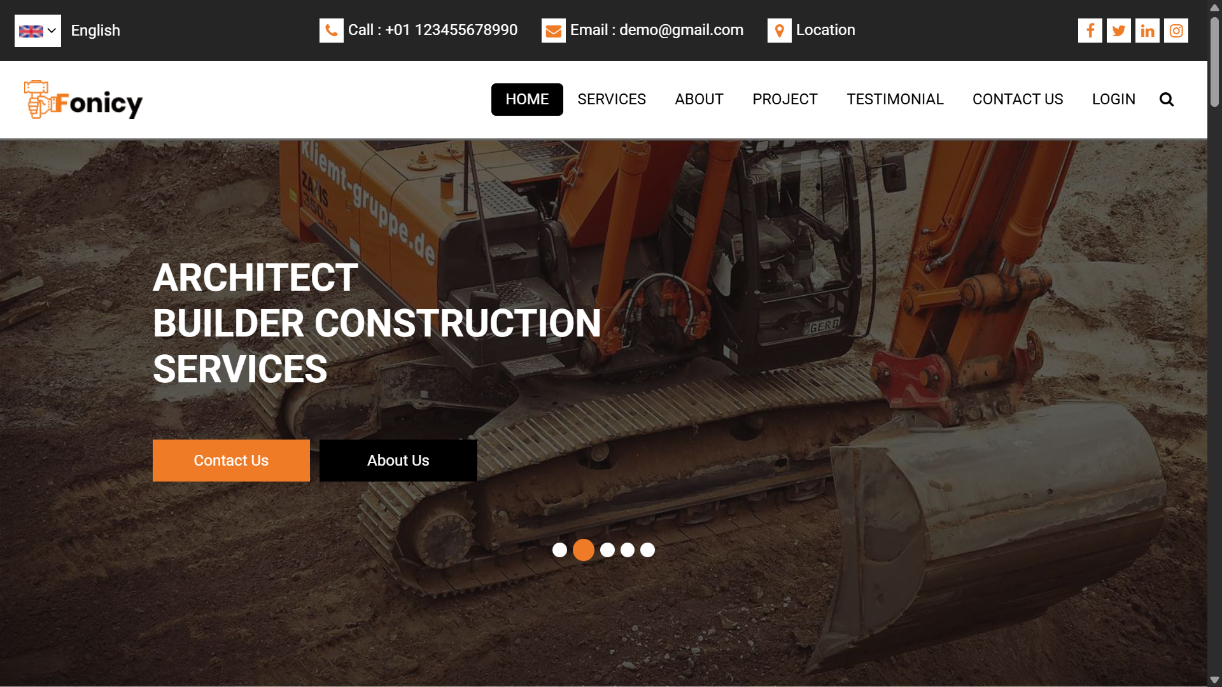
SCREENSHOTS
Fig. Home Page

Slide 16
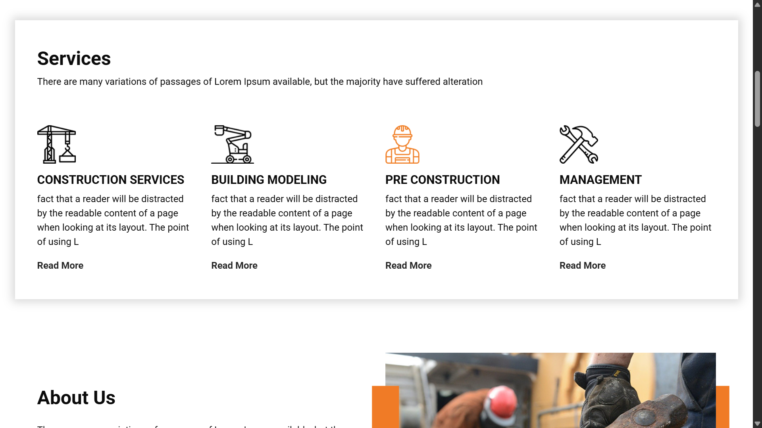
Fig. Service Page
SCREENSHOTS

Slide 17
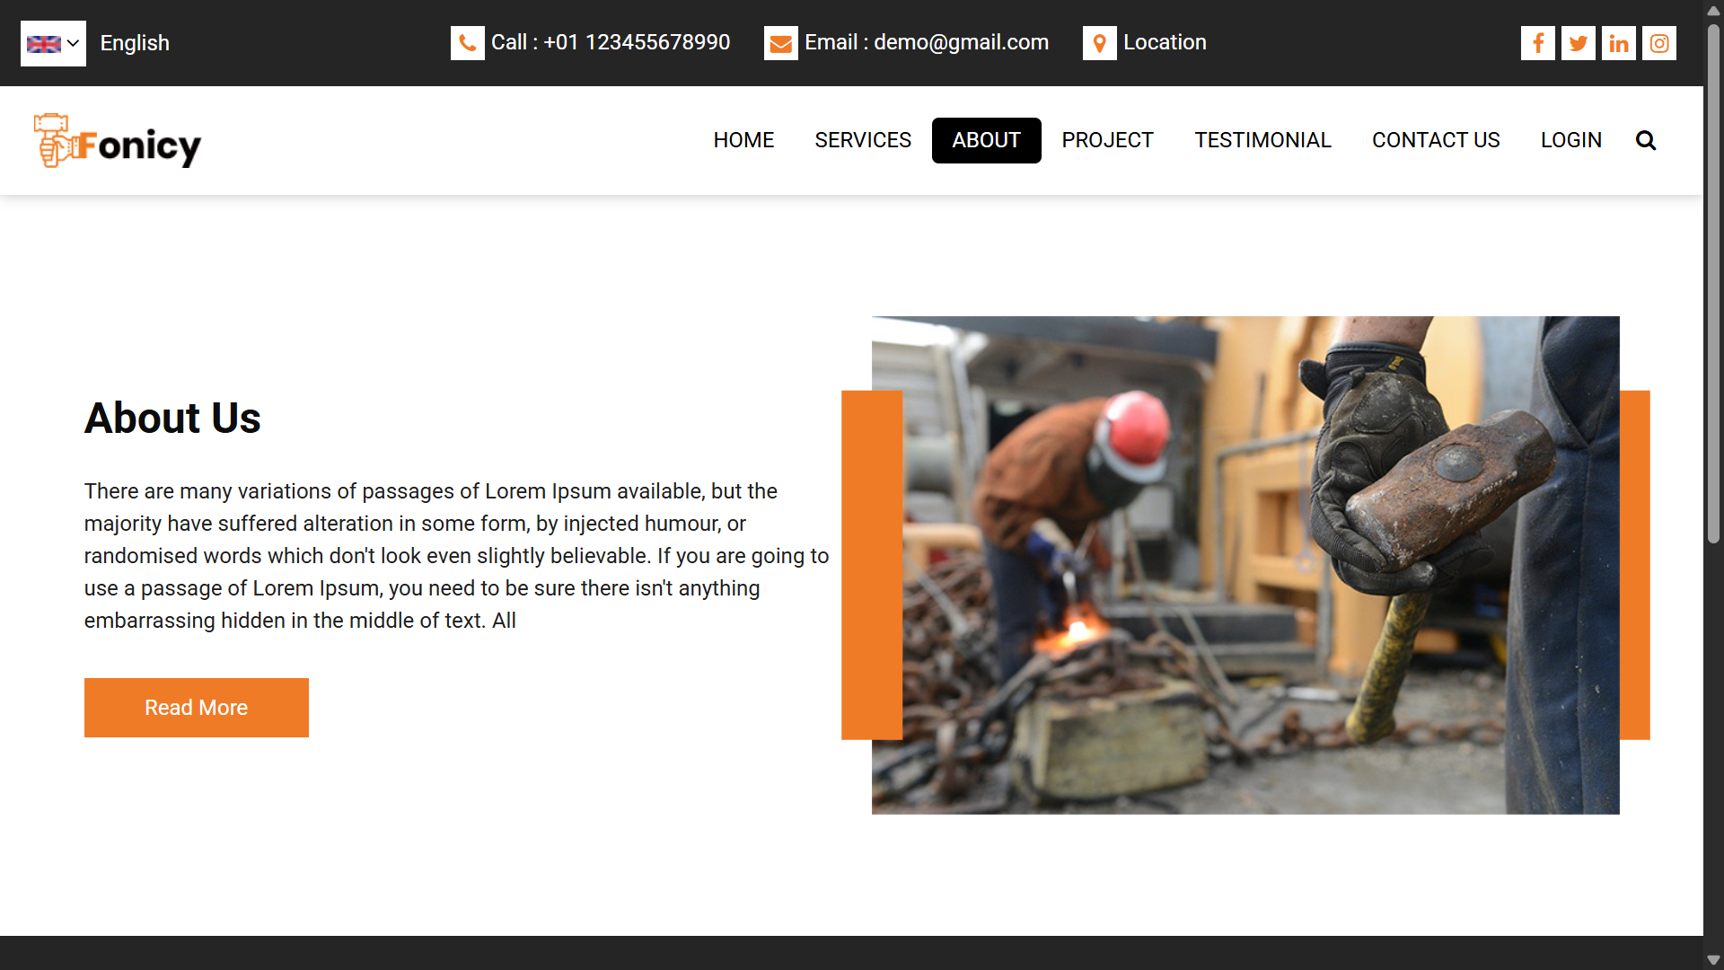
SCREENSHOTS
Fig. About Page

Slide 18
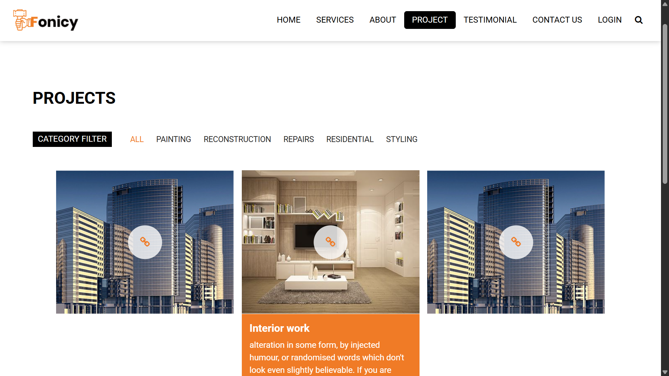
SCREENSHOTS
Fig. Projects Page

Slide 19
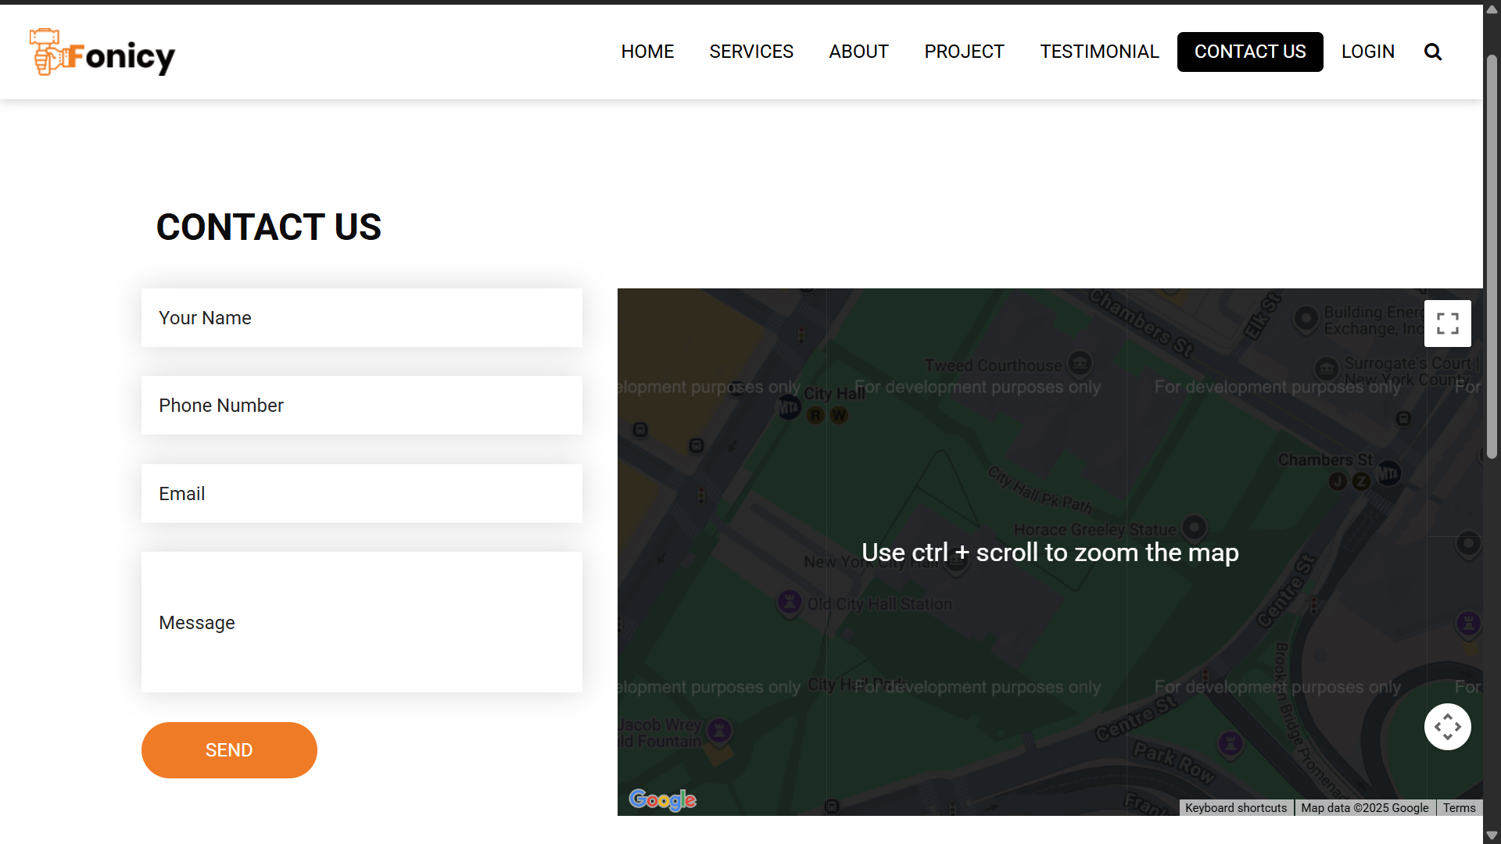
SCREENSHOTS
Fig. Contact Page

